Slide 1
SMART DRYING RACK

Slide 2

Never use your traditional dryer again
Manage your drying routine with our advanced technology tools
Stend-ino controlled by StendApp

Slide 3

Dryers are bad, use the sun instead!
«Dryer is the major contributor to emissions. It takes five to ten times the power of a washing machine»
New York Times
«Tumble dryers release harmful microfibers into the air, putting wildlife and environment at risk»
StudyFinds

Slide 4
Powered by the sun, controlled by your phone.
Combines the convenience of traditional drying racks with the advanced technology of the Internet of Things
Laundry routine easier and more efficient
Easy set up for your Stend ecosystem

Slide 5



Automated control → ability to predict drying times, the smart drying rack takes care of the rest, freeing up your time and effort
Remote monitoring → you can check the status of your drying clothes from anywhere, at any time, through the mobile app.
Community control → notifications based on the actions of users near you

Slide 6

Automated control
Our software manages to predict the best moment to dry your clothes based on the weather at your specific location
Predict the drying time thanks to sofisticated sensors and algorithms

Slide 7

Remote monitoring
Monitor the moisture of your attire anywhere you want and the progress of your laundry, even when you're not at home
Check the conditions of the environment
With a connected app, you can monitor the status of your clothes as they dry, receive alerts when the cycle is complete and visualize statistics

Slide 8

Community control
Gain useful information regarding the drying cycles of your neighbors
Get information about sudden weather events thanks to people connected nearby

Slide 9

StendApp

Slide 10

StendApp
You can login into your account to monitor the status of your Stend-ino
Predict the best moment to dry your clothes with a forecast function
Manage your account and change user information

Slide 11
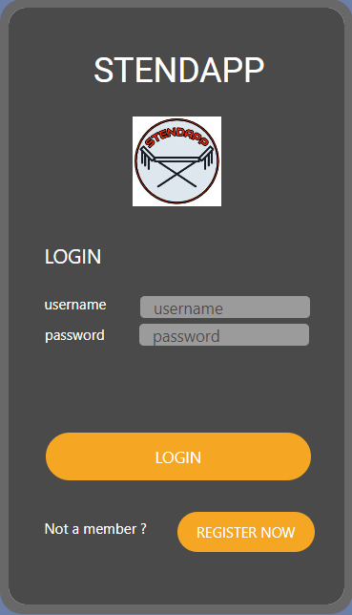
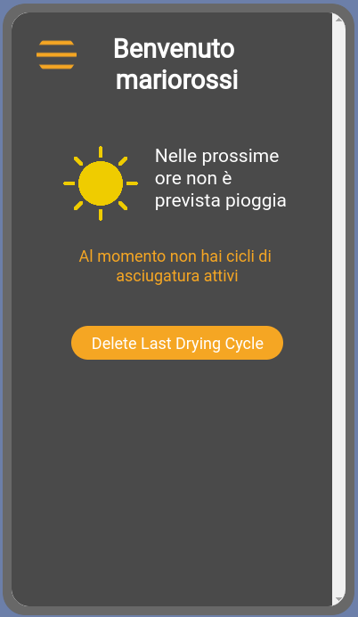
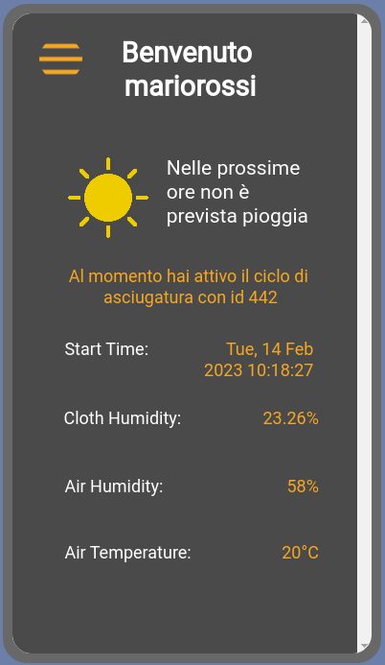
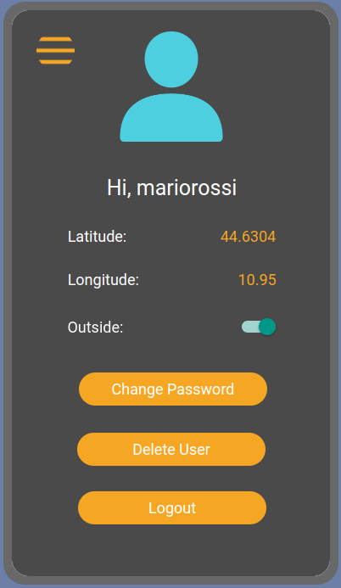

Slide 12

@the_smart_stendino_bot
Every functionality of StendApp can be performed with a telegram bot without having to download another application on your phone

Slide 13
Architecture

Slide 14









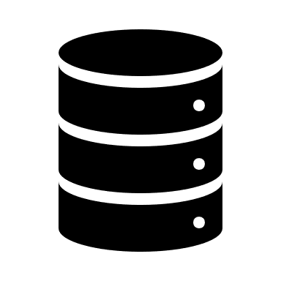


Slide 15
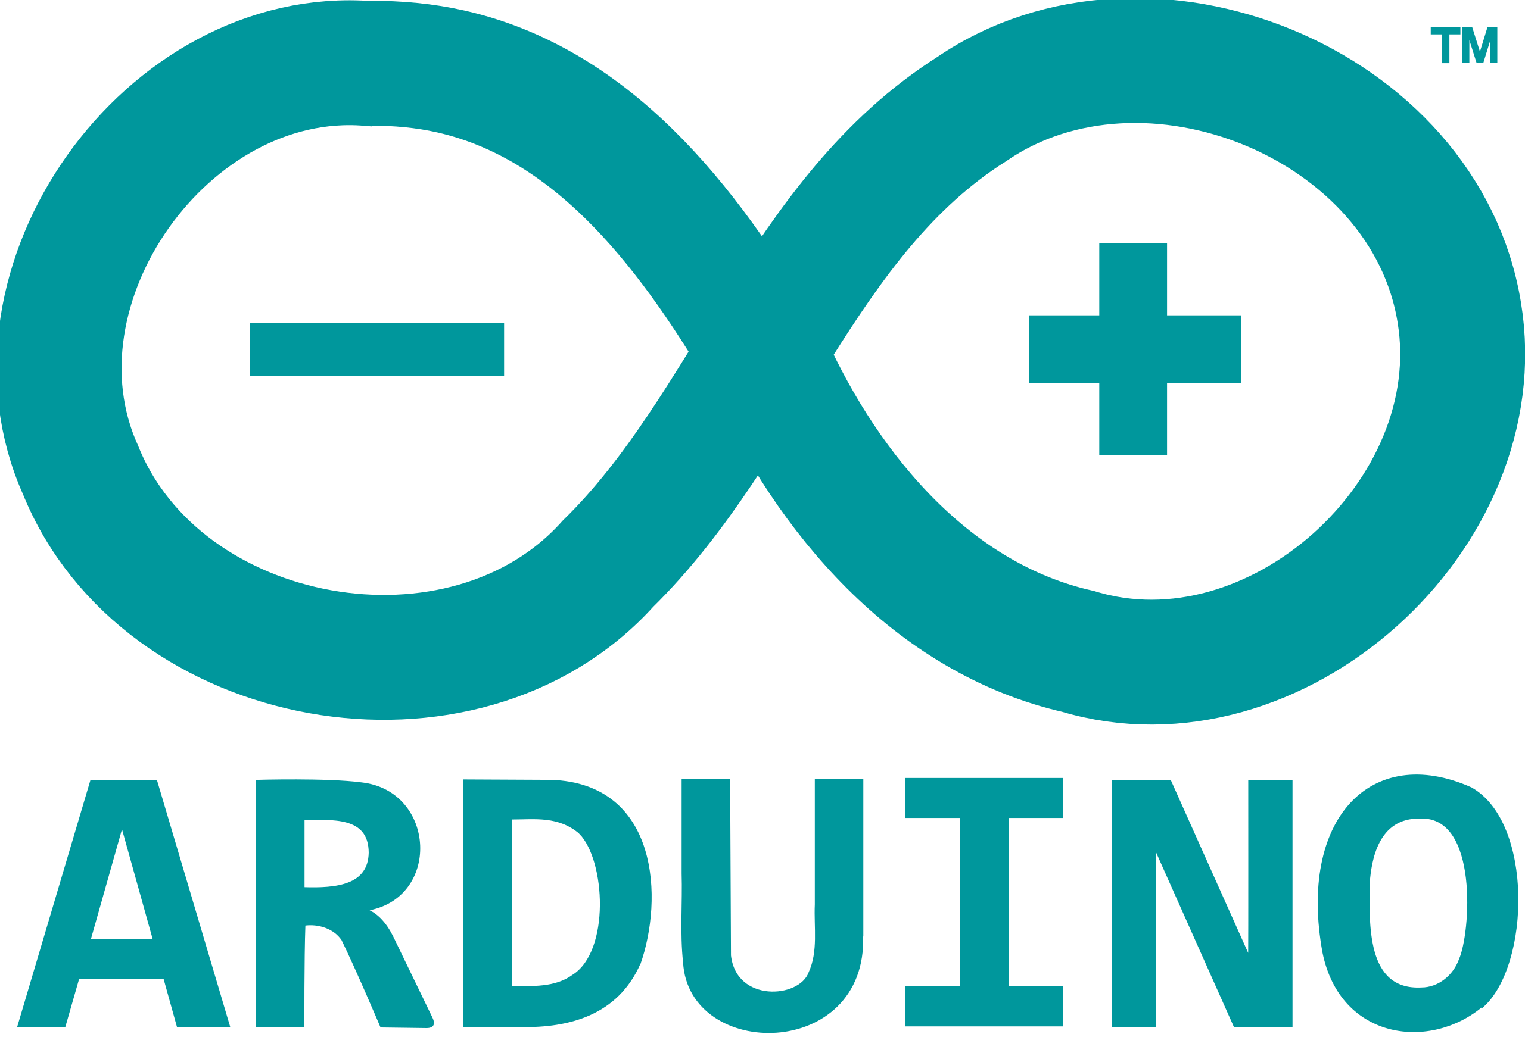
Microcontroller to manage sensors and actuators
Communication with the bridge via serial port or through wireless protocols in order to send and receive data and informations
Easy to setup

Slide 16

Bridge
Manages communication between the microcontroller and the cloud
Sends data from the sensors to the server and it handles the drying cycle
Sends data to the microcontroller in order to control the actuators behaviour

Slide 17

Web application framework for building scalable, high-performance, and easy-to-deploy RESTful APIs by providing a simple and flexible framework for handling HTTP requests and responses
RESTful APIs use HTTP methods (such as GET, POST, PUT, DELETE, etc.) to perform operations on resources, where resources are identified by URIs (Uniform Resource Identifiers)

Slide 18

request parsing
URL routing
support for returning JSON and other data formats
Flask applications can be easily deployed on a variety of platforms, including cloud-based platforms like AWS
Allows you to connect to various databases to have persistent data and make queries ( CRUD operations )

Slide 19

Tool for documenting and testing REST APIs
Provides a user-friendly interface for API documentation and testing, which can save time and effort for both developers and API users
Swagger helps enforce consistent documentation and request/response structures for your API

Slide 20

Database used to store data in a persistent way
Schema is masked by Flask Restful APIs

Slide 21

AWS
Elastic Beanstalk is a service for deploying and scaling web applications and services in the AWS Cloud
Support for different programming languages and diverse frameworks and web stacks
Creation of an environment that runs the application
Ideal for web application
hosting web applications without needing to maintain your own server, networking, domain

Slide 22
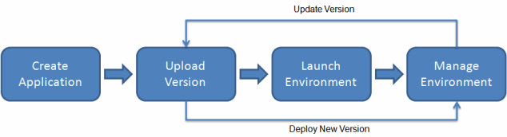
Elastic BeanStalk
manages automatically the deployment
capacity provisioning
load balancing
auto scaling
application health monitoring
log file access

Slide 23
Prototype

Slide 24
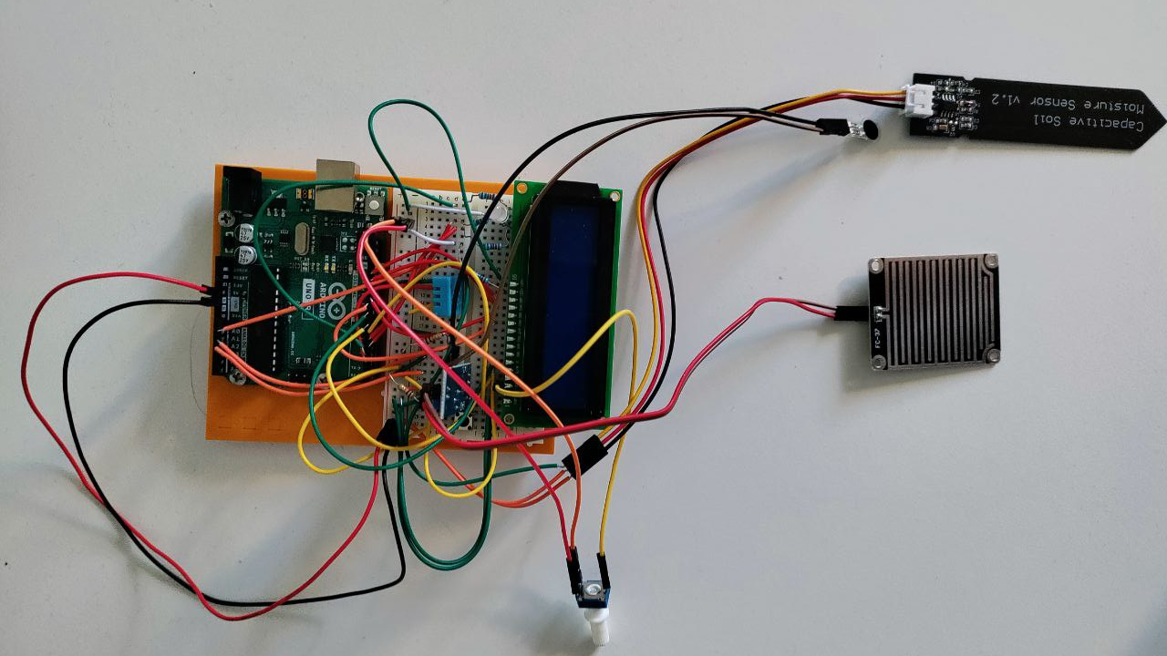

Slide 25
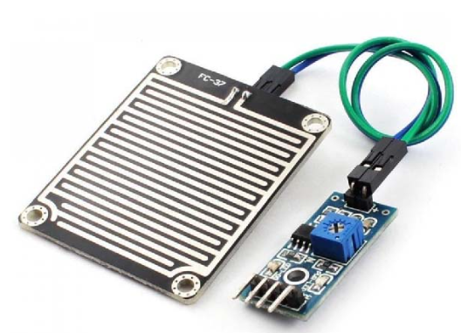
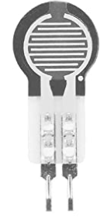
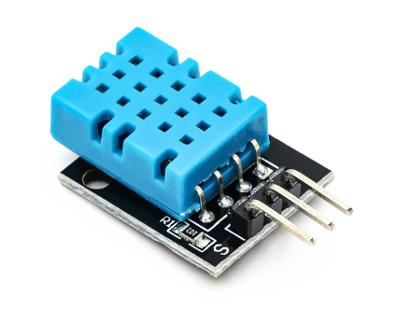
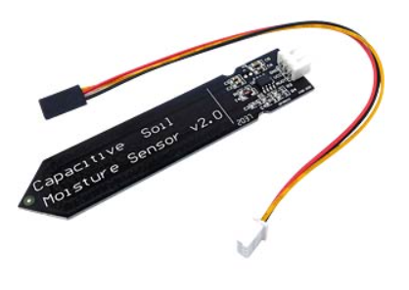
Sensors
DHT11
Capacitive Moisture Soil Sensor
Force Sensitive Resistor
Rain Sensor ( FC-37 )

Slide 26
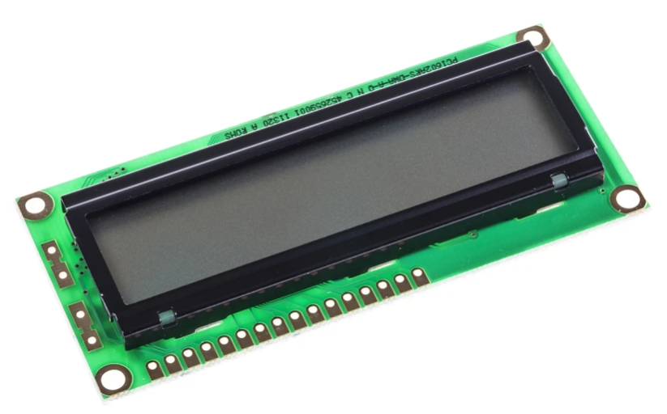
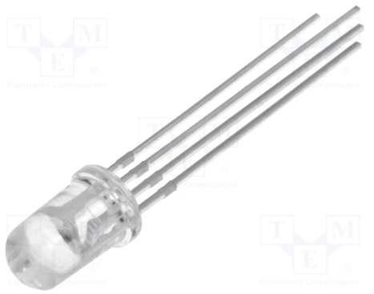
Actuators
Led RGB
LCD display 16 X 2

Slide 27
Arduino Script
Reads data from sensors and sends them to the bridge through the serial port every 5 minutes
In particular the packet is composed by air humidity, air temperature, cloth humidity, cloth weight and raining feed
Reads from the serial port, it controls the rgb led and it shows the status of the clothes and notifications on the display
The packet received from the bridge is composed by a notify byte and percentage of the drying cycle. It can also receive start and finish message (asynchronous)
Decision making and elaboration is executed on the bridge and on the server

Slide 28
Bridge
First of all, it performs login and access logic with credentials of the user. It connects on the serial port, waits for packets from the microcontroller and it elaborates the data inside it
Sends elaborated data to the server thanks to HTTP requests
In addition, every 5 minutes it checks for important weather events, community events and the progress of the drying
Eventually, it sends a notification packet to the microcontroller

Slide 29
Flask
Receives HTTP requests from the client side, performs some integrity checks and it stores the data of the user and its drying cycle without showing externally the database structures
It is responsible for statistics computations, and it masks underlying OpenWeather API call
It is the core for every CRUD operations of the database like the registation of a new user, credential checks for login access, setting and updating drying cycles

Slide 30
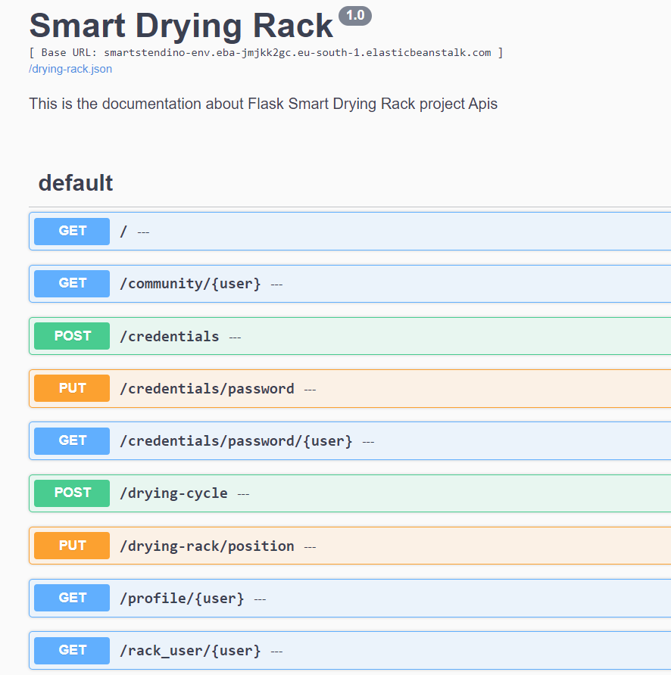
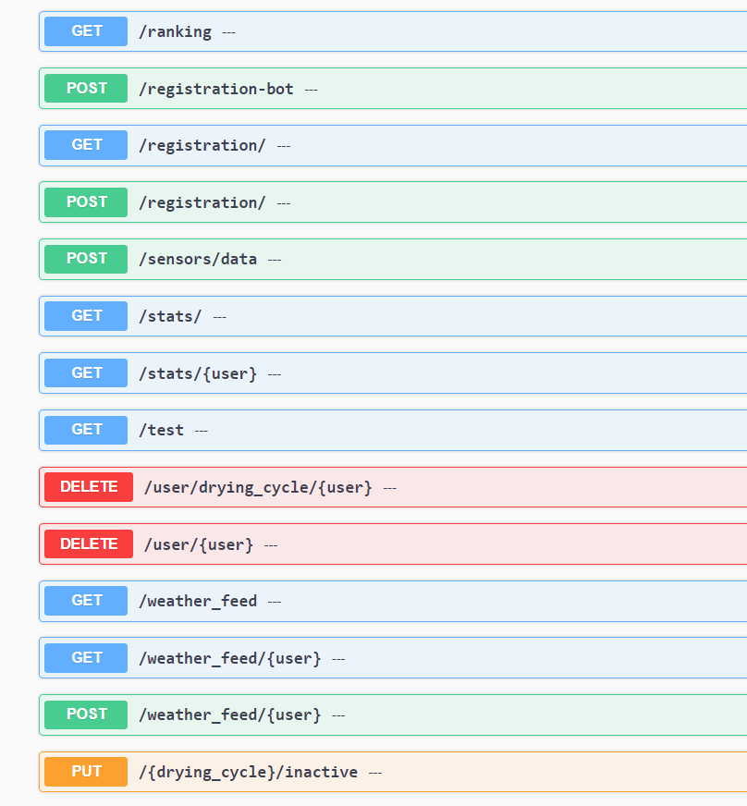

Slide 31
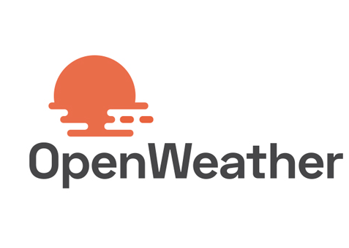
Service that provides access to real time and forecasted weather data for various locations around the world.
Our code manages to retrieve temperature, rain probability and humidity from API. It can provide the best time to dry your clothes within the next 48 hours and it alerts for incoming rain.

Slide 32
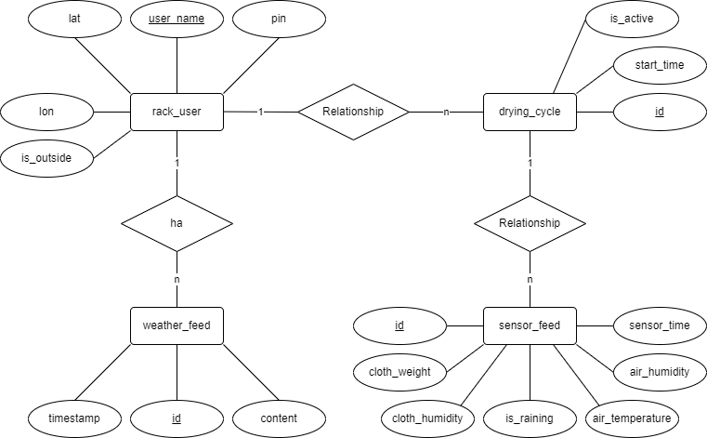
Database
Initially it was hosted thanks to a local MySQL DBMS instance, then it was migrated to the AWS Cloud with Amazon RDS service and coupled with Elastic BeanStalk environment

Slide 33

Hamachi VPN
During development and testing phases a VPN was used to connect all our devices to a virtual local subnet in order to have access to the same instance of the database

Slide 34
Telegram bot
It handles registation of new users, login to account and deletion of user information if needed
It sends messages to notify the user about weather events (rain coming in a few hours), actual rain and community events
You can ask it the status of your rack, useful informations about drying time and predict the best time to dry your clothes
Developed in Python and it will be hosted in Cloud environment in future developments
Quick and responsive for the client

Slide 35

Thunkable
Thunkable is a no-code platform that allows users to create and publish their own mobile apps
It has an intuitive drag-and-drop interface and a library of pre-built components that users can use to build their apps (design and blocks)
Support for both iOS and Android app development
It allows for integration with a variety of third-party services

Slide 36

Future evolution
AI, ML and DL (Recurrent neural networks) → predict drying times with a correlation to the environment
Integration of other AWS services for Artificial Intelligence and Internet of Things
New functionalities for the mobile application to give more reliable information, security and privacy of the sensible data

Slide 37
Future evolution
Waterproof system evolution, usage of smart sensors for collecting data and multiple concurrent drying cycles for user
Improve scalability and performances of Flask Restful APIs
Wireless connections
Predictions based on the type of clothing item

Slide 38
Thanks for your attention!

